Slide 1
Chapter 12
Distributed Database Management Systems

Slide 2
Learning Objectives
In this chapter, you will learn:
About distributed database management systems (DDBMSs) and their components
How database implementation is affected by different levels of data and process distribution
How transactions are managed in a distributed database environment
How distributed database design draws on data partitioning and replication to balance performance, scalability, and availability
About the trade-offs of implementing a distributed data system

Slide 3
Evolution of Database Management Systems
Distributed database management system (DDBMS) governs storage and processing of logically related data over interconnected computer systems
Data and processing functions are distributed among several sites
Centralized database management system
Required that corporate data be stored in a single central site
Data access provided through dumb terminals

Slide 4
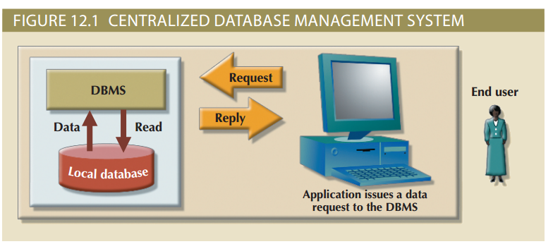
Figure 12.1 - Centralized Database Management System

Slide 5
Changes that Affected the Nature of Systems
Globalization of business operation
Market needs for an on-demand transaction style, based on web-based services
Rapid social and technological changes fueled by low-cost smart mobile devices
Data realms converging in the digital world
Advent of social media to reach new customers and markets

Slide 6
Database Requirements in a Dynamic Business Environment
Rapid ad hoc data access
Crucial in the quick-response decision-making environment
Distributed data access
Needed to support geographically dispersed business units

Slide 7
Factors that Influenced DDBMS
Acceptance of Internet as a platform for business
Mobile wireless revolution
Growth of use of “application as a service”
Focus on mobile business intelligence
Emphasis on Big Data analytics

Slide 8
Potential Centralized DBMS Problems
Performance degradation
High costs
Reliability problems
Scalability problems
Organizational rigidity

Slide 9
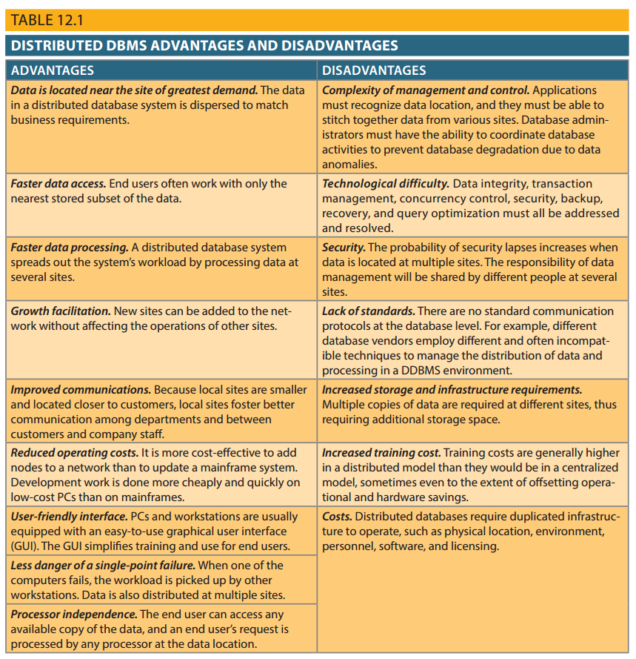
Table 12.1 – Distributed DDBM Advantages and Disadvantages

Slide 10
Distributed Processing and Distributed Databases
Distributed processing: Database’s logical processing is shared among two or more physically independent sites via network
Distributed database: Stores logically related database over two or more physically independent sites via computer network
Database fragments: Database composed of many parts in distributed database system

Slide 11
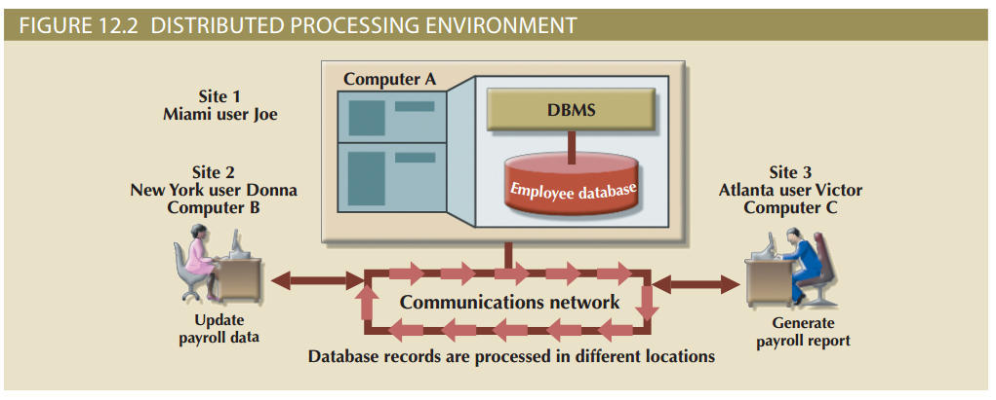
Figure 12.2 – Distributed Processing Environment

Slide 12
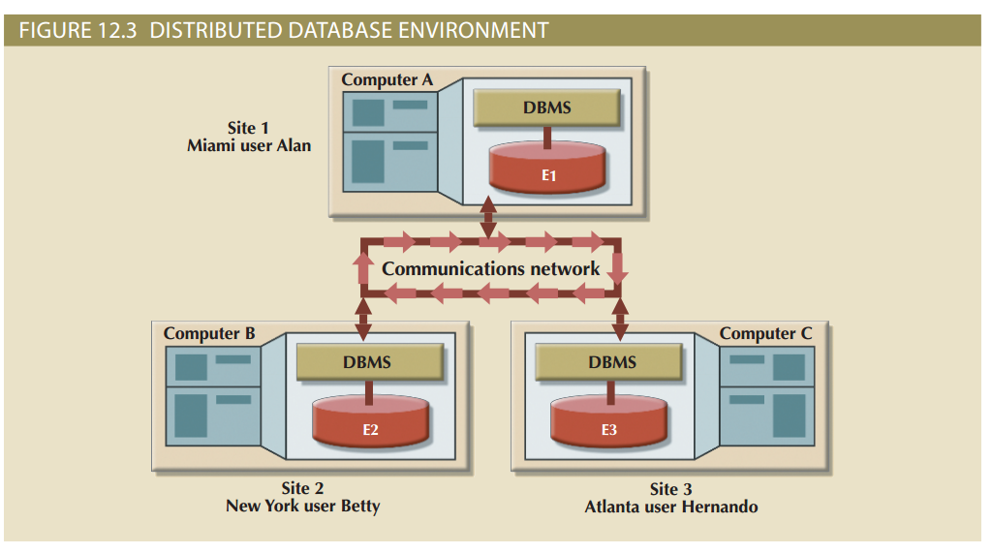
Figure 12.3 – Distributed Database Environment

Slide 13
Characteristics of Distributed Management Systems
Application interface
Formatting
Validation
Transformation
Query optimization
Mapping
I/O interface
Security
Backup and recovery
DB administration
Concurrency control
Transaction management

Slide 14
Functions of Fully Distributed DBMS
Receive the request of an application or end user
Validate, analyze, and decompose the request
Map request’s logical-to-physical data components
Decompose request into several I/O operations
Search, locate, read and validate data
Ensure database consistency, security, and integrity
Validate data for conditions specified by request
Present data in required format
Handle all necessary functions transparently to user

Slide 15
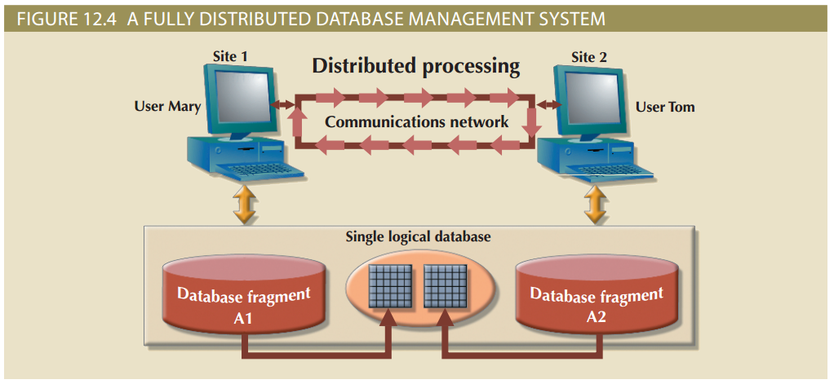
Figure 12.4 - A Fully Distributed Database Management System

Slide 16
DDBMS Components
Computer workstations or remote devices
Network hardware and software components
Communications media
Transaction processor (TP): Software component in each computer or device that requests data
Known as transaction manager (TM) or application processor (AP)
Data processor (DP) or data manager (DM)
Software component on each computer or device that stores and retrieves data from located at the site

Slide 17
Single-Site Processing, Single-Site Data (SPSD)
Processing is done on a single host computer
Data stored on host computer’s local disk
Processing restricted on end user’s side
DBMS is accessed by dumb terminals

Slide 18
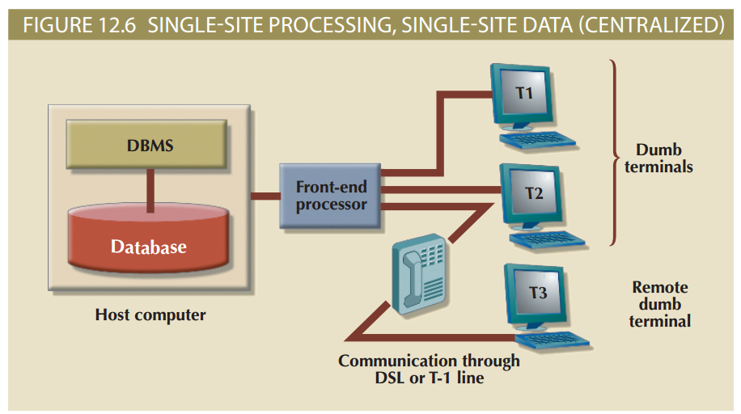
Figure 12.6 - Single-Site Processing, Single-Site Data (Centralized)

Slide 19
Multiple-Site Processing, Single-Site Data (MPSD)
Multiple processes run on different computers sharing a single data repository
Require network file server running conventional applications
Accessed through LAN
Client/server architecture
Reduces network traffic
Processing is distributed
Supports data at multiple sites

Slide 20
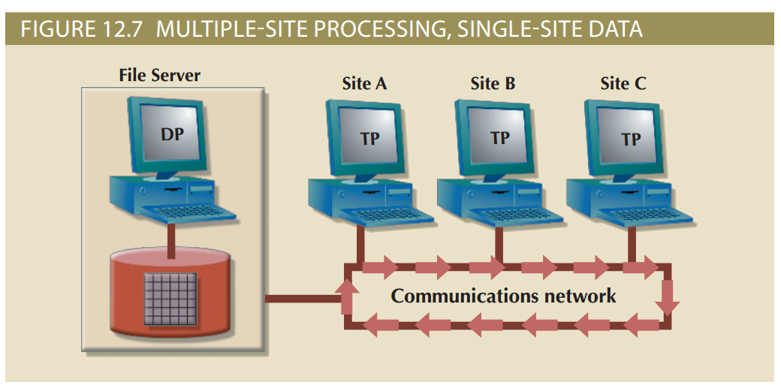
Figure 12.7 - Multiple-Site Processing, Single-Site Data

Slide 21
Multiple-Site Processing, Multiple-Site Data (MPMD)
Fully distributed database management system
Support multiple data processors and transaction processors at multiple sites
Classifications:
Homogeneous: Integrate multiple instances of same DBMS over a network
Heterogeneous: Integrate different types of DBMSs over a network
Fully heterogeneous: Support different DBMSs, each supporting different data model running under different computer systems

Slide 22
Restrictions of DDBMS
Remote access is provided on a read-only basis
Restrictions on the number of remote tables that may be accessed in a single transaction
Restrictions on the number of distinct databases that may be accessed
Restrictions on the database model that may be accessed

Slide 23
Distributed Database Transparency Features
Distribution transparency
Transaction transparency
Failure transparency
Performance transparency
Heterogeneity transparency

Slide 24
Distribution Transparency
Allows management of physically dispersed database as if centralized
Levels: Fragmentation, location and local mapping
Unique fragment: Each row is unique, regardless of the fragment in which it is located
Supported by distributed data dictionary (DDD) or distributed data catalog (DDC)
DDC contains the description of the entire database as seen by the database administrator
Distributed global schema: Common database schema to translate user requests into subqueries

Slide 25
Transaction Transparency
Ensures database transactions will maintain distributed database’s integrity and consistency
Ensures transaction completed only when all database sites involved complete their part
Distributed database systems require complex mechanisms to manage transactions

Slide 26
Distributed Requests and Distributed Transactions
Remote request
Remote transaction
Distributed transaction
Distributed request
Single SQL statement accesses data processed by a single remote database processor
Accesses data at single remote site composed of several requests
Requests data from several different remote sites on network
Single SQL statement references data at several DP sites

Slide 27
Distributed Concurrency Control
Concurrency control is especially important in distributed databases environment
Multi-site, multiple-process operations are more likely to create inconsistencies and deadlocked transactions
Solution to inconsistent database is a two-phase commit protocol

Slide 28
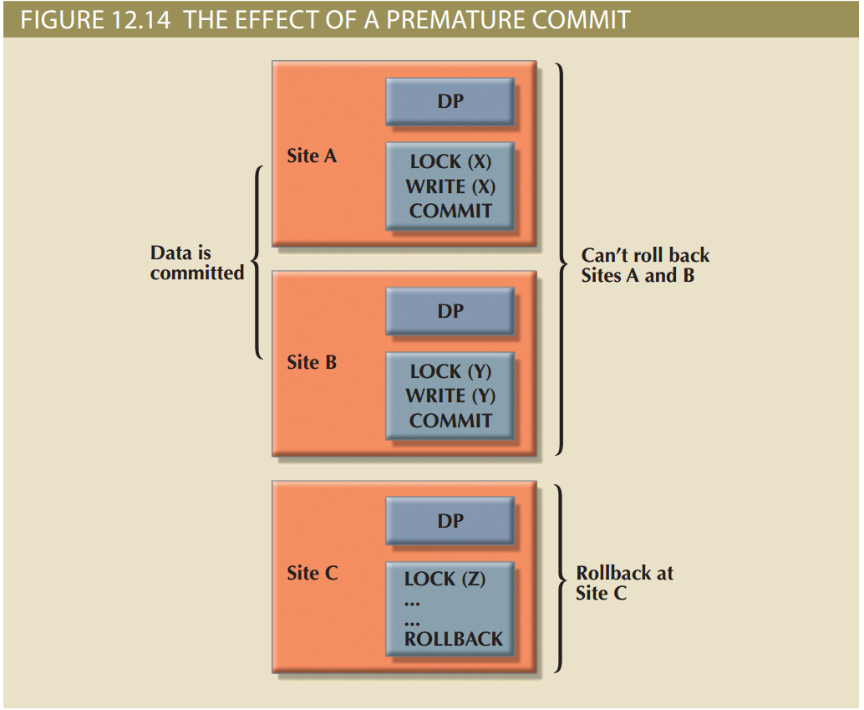
Figure 12.14 - The Effect of Premature COMMIT

Slide 29
Two-Phase Commit Protocol (2PC)
Guarantees if a portion of a transaction operation cannot be committed, all changes made at the other sites will be undone
To maintain a consistent database state
Requires that each DP’s transaction log entry be written before database fragment is updated
DO-UNDO-REDO protocol: Roll transactions back and forward with the help of the system’s transaction log entries

Slide 30
Two-Phase Commit Protocol (2PC)
Write-ahead protocol: Forces the log entry to be written to permanent storage before actual operation takes place
Defines operations between coordinator and subordinates
Phases of implementation
Preparation
The final COMMIT

Slide 31
Performance and Failure Transparency
Performance transparency allows a DDBMS to perform as if it were a centralized database
Failure transparency ensures the system will operate in case of network failure
Objective of query optimization is to minimize total costs which are a function of:
Access time (I/O) cost involved in accessing data from multiple remote sites
Communication costs associated with data transmission
CPU time cost associated with the processing overhead

Slide 32
Performance and Failure Transparency
Considerations for resolving data requests in a distributed data environment:
Data distribution and data replication
Replica transparency: DDBMS’s ability to hide multiple copies of data from the user
Network and node availability
Network latency: Delay imposed by the amount of time required for a data packet to make a round trip
Network partitioning: Delay imposed when nodes become suddenly unavailable due to a network failure

Slide 33
Distributed Database Design
Data fragmentation
How to partition database into fragments
Data replication
Which fragments to replicate
Data allocation
Where to locate those fragments and replicas

Slide 34
Data Fragmentation
Breaks a single object into two or more segments
Information is stored in distributed data catalog (DDC)
Strategies
Horizontal fragmentation: Division of a relation into subsets (fragments) of tuples (rows)
Vertical fragmentation: Division of a relation into attribute (column) subsets
Mixed fragmentation: Combination of horizontal and vertical strategies

Slide 35
Data Replication
Storage of data copies at multiple sites served by a computer network
Mutual consistency rule requires all copies of data fragments be identical
Styles of replication
Push replication focuses on maintaining data consistency
Pull replication focuses on maintaining data availability and allows for temporary data inconistencies

Slide 36
Data Replication Scenarios
Fully replicated database
Stores multiple copies of each database fragment at multiple sites
Partially replicated database
Stores multiple copies of some database fragments at multiple sites
Unreplicated database
Stores each database fragment at a single site

Slide 37
Data Allocation Strategies
Centralized data allocation
Entire database stored at one site
Partitioned data allocation
Database is divided into two or more disjoined fragments and stored at two or more sites
Replicated data allocation
Copies of one or more database fragments are stored at several sites

Slide 38
The CAP Theorem
CAP stands for:
Consistency
Availability
Partition tolerance
Trade-off between consistency and availability generated in a new system in which data is basically available, soft state, eventually consistent (BASE)
Data changes are not immediate but propagate slowly through the system until all replicas are consistent

Slide 39
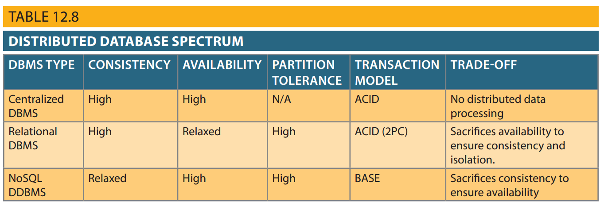
Table 12.8 - Distributed Database Spectrum

Slide 40
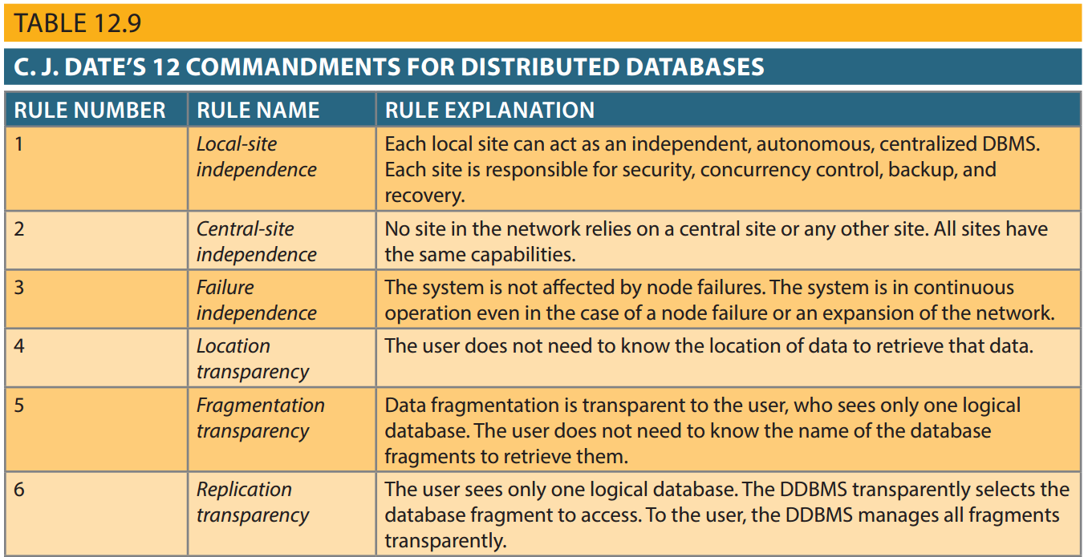
Table 12.9 - C. J. Date’s 12 Commandments for Distributed Databases

Slide 41
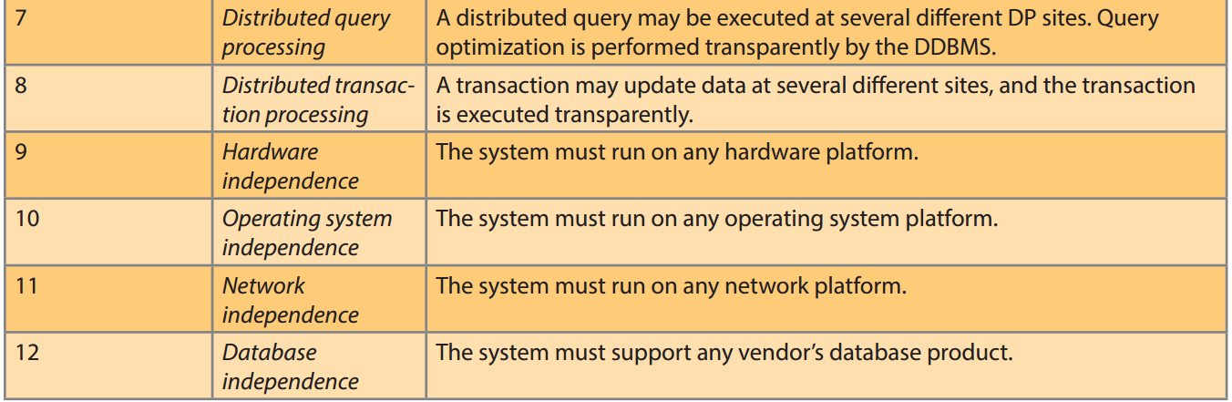
Table 12.9 - C. J. Date’s 12 Commandments for Distributed Databases (cont’d.)

